Slide 1


PILOT STUDY OF CRYOMODULATION FOR REDUCTION OF INFLAMMATION AND IMPROVEMENT OF SYMPTOMS IN PATIENTS WITH ROSACEA
Ashish C. Bhatia, MD, FAAD^{1,2}
Bruce Katz, MD^{3,4}
¹Oak Dermatology, Naperville, IL, USA; ²Northwestern University, Feinberg School of Medicine, Chicago, IL, USA
³JUVA Skin and Laser Center, New York, NY, USA; ⁴Mt. Sinai School of Medicine, New York, NY, USA
MKT-1328 REV A | ©2025 R2 TECHNOLOGIES. ALL RIGHTS RESERVED.

Slide 2
DISCLOSURES
Dr. Bhatia and Dr. Katz served as investigators in the pilot study
MKT-1328 REV A | ©2025 R2 TECHNOLOGIES. ALL RIGHTS RESERVED.

Slide 3
BACKGROUND
Rosacea is a common chronic inflammatory skin condition characterized by facial flushing, erythema, telangiectasia, and papules or pustules
Hyperreactive immune response to environmental triggers induces a signaling cascade of inflammatory factors that lead to chronic inflammation and an altered vascular state
Current therapies: topical and oral medications, laser and light therapies, trigger avoidance
Novel precision cooling device (Glacial Rx®, R2 Technologies, Dublin, CA) developed to deliver cryomodulation® to downregulate inflammatory processes in skin
Prior publications report efficacy of cryomodulation for reduction of inflammation post-laser treatment and in patients with acne
A pilot study was undertaken to assess the clinical impact of cryomodulation in patients with rosacea
MKT-1328 REV A | ©2025 R2 TECHNOLOGIES. ALL RIGHTS RESERVED.

Slide 4
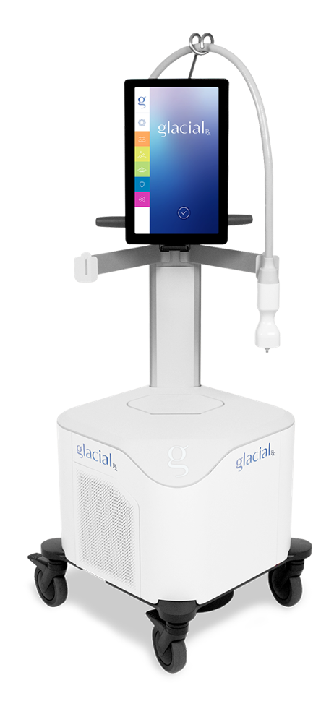
STUDY DEVICE – GLACIAL® RX SYSTEM*
Technology invented at Harvard/MGH (Drs. Anderson, Manstein, and Chan)
Device uses cryomodulation to address skin inflammation and improve the appearance of photodamaged skin
FDA-cleared: Glacial Rx is FDA-cleared for the reduction of pain, inflammation and swelling and the removal of benign lesions
*R2 Technologies, Dublin, CA
MKT-1328 REV A | ©2025 R2 TECHNOLOGIES. ALL RIGHTS RESERVED.

Slide 5
STUDY OVERVIEW
Design: prospective, non-randomized, multi-center pilot clinical study
Objective: to assess the safety and efficacy of a novel precision skin cooling device using cryomodulation to reduce symptoms of rosacea
Treatment: 5 treatment sessions at 2-week intervals
Follow-up: 1, 2, and 3 months post-treatment
Endpoints: Digital photographs, investigator grading of cosmetic improvement, subject rating of procedural comfort and treatment satisfaction
MKT-1328 REV A | ©2025 R2 TECHNOLOGIES. ALL RIGHTS RESERVED.

Slide 6
RESULTS
Total of 20 patients treated, including 19 female and 1 male patients
Average age: 47 years
Fitzpatrick skin types II-IV
MKT-1328 REV A | ©2025 R2 TECHNOLOGIES. ALL RIGHTS RESERVED.

Slide 7
RESULTS
>90% of patients had reduction in rosacea severity at 1and 2 months after final treatment
Patients reported reduced redness, reduced papules and pustules, and less frequent blushing
Patients additionally reported secondary cosmetic benefits including improved skin tone and texture and improved skin brightness and clarity
No treatment side effects, no device-related adverse events
MKT-1328 REV A | ©2025 R2 TECHNOLOGIES. ALL RIGHTS RESERVED.

Slide 8
RESULTS
>90% of patients rated by investigator as having global cosmetic improvement at 1and 2 months
100% of patients rated the procedure as comfortable
83% of patients responded that they would elect to undergo the procedure again
100% of patients responded that they would recommend the treatment to others
MKT-1328 REV A | ©2025 R2 TECHNOLOGIES. ALL RIGHTS RESERVED.

Slide 9
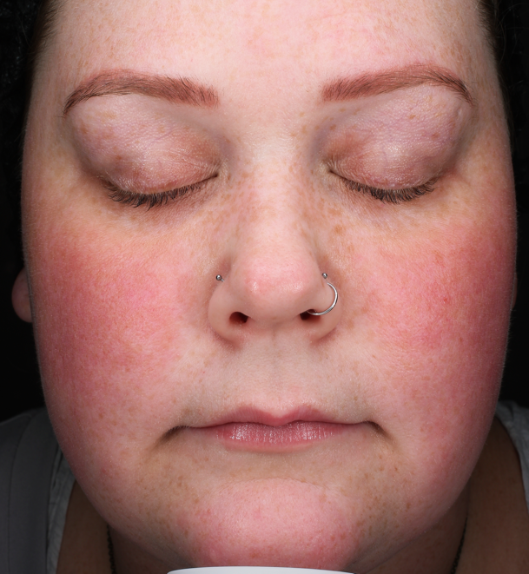
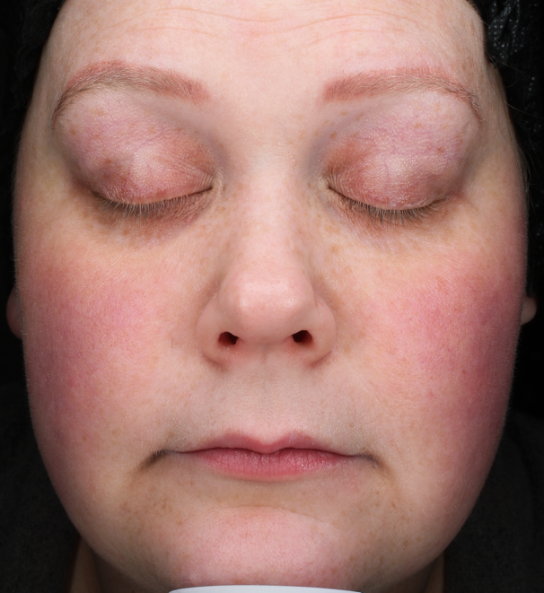
Rosacea patient was rated by physician and patient as having significant cosmetic improvement at 3 months post-treatment
Baseline
3 Months
MKT-1328 REV A | ©2025 R2 TECHNOLOGIES. ALL RIGHTS RESERVED.
Notes:
Oak009

Slide 10
CONCLUSIONS
Clinical data support the use of cryomodulation for the reduction of inflammation in patients with rosacea
Reductions in rosacea symptoms were achieved in a simple, comfortable procedure with high patient comfort and patient satisfaction
Further clinical research is necessary to clarify optimal patient selection and treatment parameters, and to establish treatment durability
MKT-1328 REV A | ©2025 R2 TECHNOLOGIES. ALL RIGHTS RESERVED.

